Slide 1
WEBPAGE CLASSIFICATION USING NATURAL LANGUAGE PROCESSING AND DEEP LEARNING
Minor Project Presentation
By
Aman Munday (01615602715)
Anurag Sharma (02215602715)
Nikhil Gaur (05915602715)
Nishant Chettri (06015602715)
Department of Computer Science & Engineering
Dr. Akhilesh Das Gupta Institute of Technology and Management, New Delhi
Guru Gobind Singh Indraprastha University, New Delhi
August,2018

Slide 2


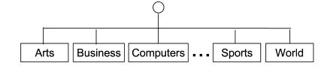
GOAL

Slide 3
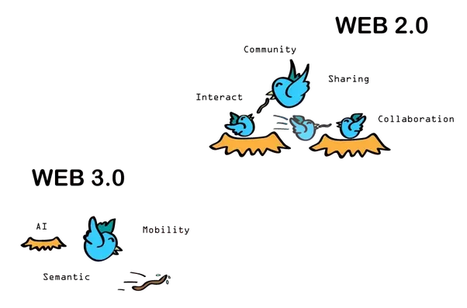
From Web 2.0 to Web 3.0
Web 2.0 – Semantic Web -> Web 3.0 – Intelligent Web
This project is step towards transforming the
web and make it more intelligent.

Slide 4

Why we classify?

Slide 5
The answer to Why
Assigning webpage to one or more category labels e.g. news, sports, education, etc
Classification plays a vital role in many information management and retrieval tasks.
On the Web, classification of page content is essential to focused crawling,
to the assisted development of web directories, to topic-specific Web link analysis,
to contextual advertising,
and to analysis of the topical structure of the Web.
Web page classification can also help improve the quality of Web search.
Web page classification is a vital task for improving the quality of web search, assisted web browsing and knowledge base construction and many more.

Slide 6

Long Story Short
To process huge number of pages and
categorize them manually by a human cannot
be imagined. But AI comes to
rescue and we use it’s power
to solve this problem.

Slide 7

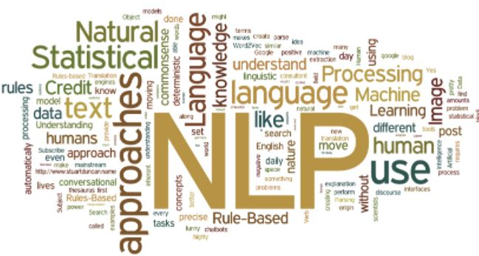
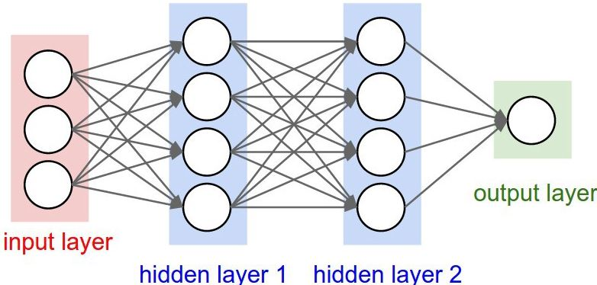
How?
Using Natural Language Processing and Deep Learning Algorithms

Slide 8

But are Text Classification & Web Categorization same roads?

Slide 9

The Answer

Slide 10
Difference between Text Classification and Web Page Classification
Text Classification | Web Page Classification
Traditional text classification is typically performed on structured documents. [Chekuri et al. 1997] | Web pages are semi structured documents in HTML, so that they may be rendered visually for users.
Text documents doesn’t exist with connections to and from other documents. | Web documents exist within a hypertext, with connections to and from other documents.

Slide 11

Therefore, Web classification is not only important, but distinguished from traditional text classification, and thus deserves more focused review

Slide 12

Challenges

Slide 13
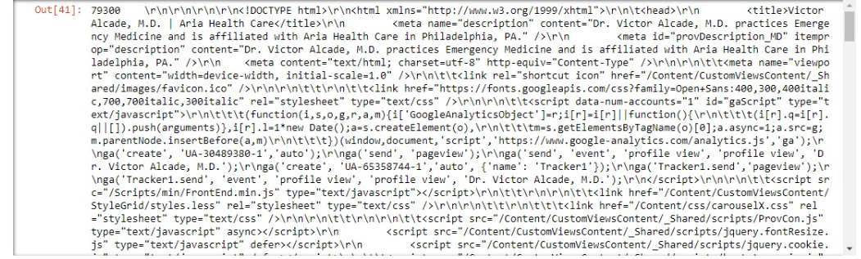
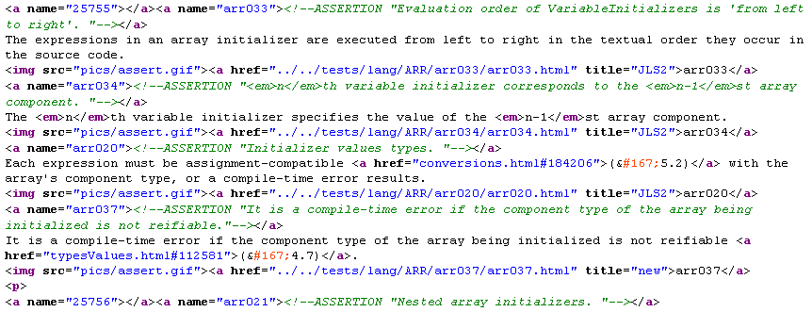
To Convert This

Slide 14

To This
“Sports”

Slide 15
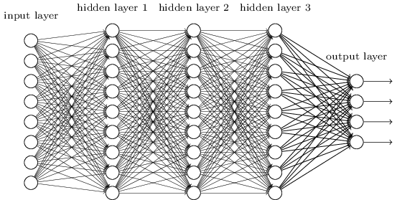
Using this

Slide 16
So How do we do this
Data Preprocessing
Natural Language Preprocessing
Deep Learning
Model Comparison
Final Evaluation & Analysis

Slide 17
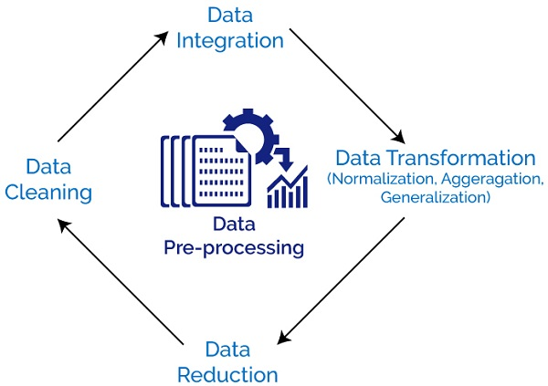
Data Preprocessing

Slide 18

Natural Language Processing
It is concerned with
Interaction between human
& computers
The main goal is to make
computers understand &
analyze natural human language

Slide 19
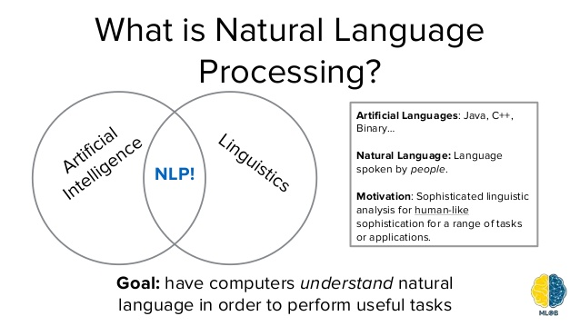

Slide 20
NLP TOOLS
Text Preprocessing Noise Removal
Lexicon Normalization
Lemmatization
Stemming
Statistical features
TF – IDF
Frequency / Density Features
Readability Features
Word Embeddings

Slide 21
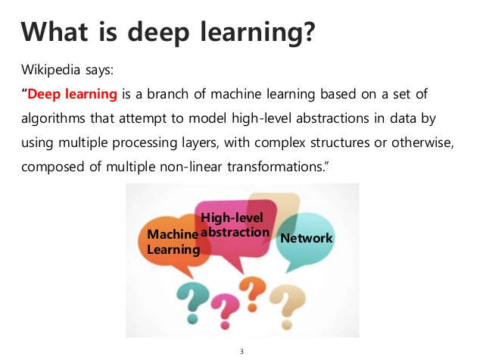

Slide 22
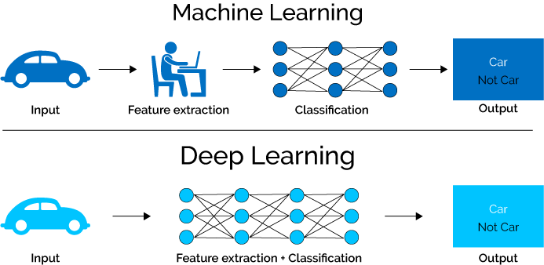

Slide 23
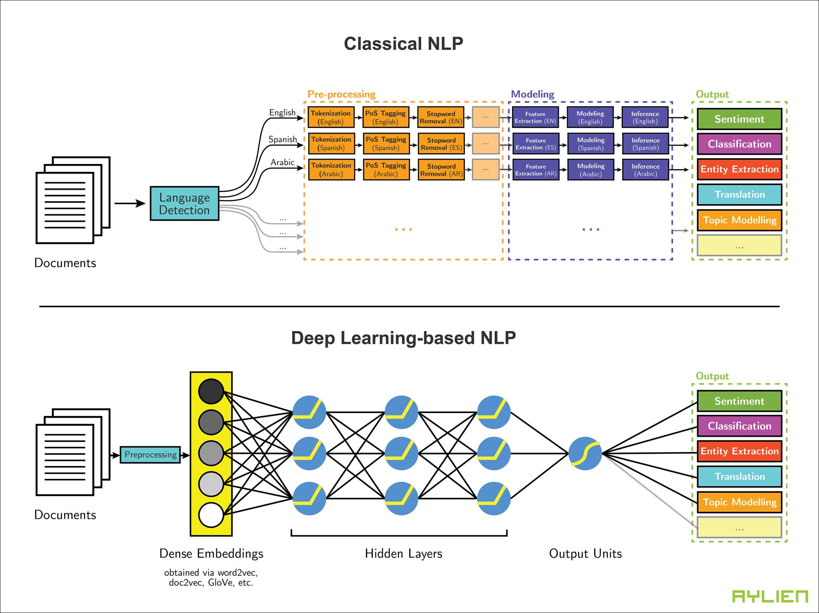

Slide 24









Tools

Slide 25
Deadlines
Aug 20- Aug 30 : Preparing and Preprocessing
Sep 1 - Sep 15 : Feature Engineering and Natural Language Processing.
Sep 15 - Sep 30: Model Training and validation
Oct 1 - Oct 25: Improving accuracy and comparing various models
Oct 26 : Final Report Submission

Slide 26


